Slide 1



Revealing the Bias Within
Addressing Implicit Bias in the Peri-operative Workplace
Marckenley Isaac, M.D., PGY-2 Resident; Olga Paniagua, M.D., PGY-3 Resident;
Bryan Mahoney, M.D., F.A.S.A., Associate Professor, Residency Program Director, Vice Chair, Education
Department of Anesthesiology,
Perioperative and Pain Medicine;
Mount Sinai Morningside and West Hospitals,
Icahn School of Medicine at Mount Sinai

Slide 2
CONFLICTS OF INTEREST: NONE
This project was conducted with funding from the American Society of Anesthesiologists Committee for Professional Diversity Grant

Slide 3
Objectives
Recognize the experience of others impacted by implicit bias
Understand the role of bystanders in becoming allies to combat implicit bias
Practice strategies for intervention in instances of implicit bias in the perioperative workplace

Slide 4
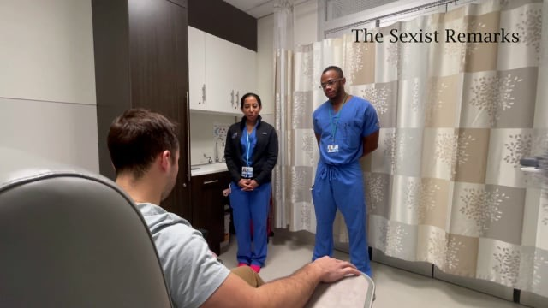

Slide 5
Implicit bias
“attitudes we have towards people or associate stereotypes with them without our conscious knowledge.”*
  *https://perception.org/research/implicit-bias/
  “in social identity theory, an implicit bias or implicit stereotype, is the pre-reflective attribution of particular qualities by an individual to a member of some social out group.”*
    *https://en.wikipedia.org/wiki/Implicit_stereotype
    “unconscious attitudes and stereotypes that can manifest in the criminal justice system, workplace, school setting, and in the healthcare system.”*
      *https://www.simplypsychology.org/implicit-bias.html

Slide 6
microaggression
“a statement, action, or incident regarded as an instance of indirect, subtle, or unintentional discrimination against members of a marginalized group such as a racial or ethnic minority.”*
  *https://languages.oup.com/google-dictionary-en/
  “brief and commonplace daily verbal, behavioral or environmental indignities, whether intentional or unintentional, that communicate hostile, derogatory, or negative attitudes toward stigmatized or culturally marginalized groups”*
    *https://en.wikipedia.org/wiki/Microaggression
    “the kinds of remarks, questions, or actions that are painful because they have to do with a person's membership in a group that's discriminated against or subject to stereotypes. And a key part of what makes them so disconcerting is that they happen casually, frequently, and often without any harm intended, in everyday life”*
      *https://www.vox.com/2015/2/16/8031073/what-are-microaggressions

Slide 7
What we did and why
We aimed to provide insight into these phenomena from the perspective of those experiencing them.
We interviewed trainees from around the nation to hear, in their words, their experiences and how it made them feel.

Slide 8
What we did and why
Based on these interviews, we scripted scenarios to present the experiences (with the knowledge of those interviewed).
All characters in these scenarios are actors with knowledge of the script EXCEPT the bystander.
Following an initial simulated scenario, allyship training was provided to the bystander to apply in a repetition of the initial scenario.

Slide 9
What we did and why
If the unspoken rules governing our behavior are not accounting for the way they negatively impacts others, it is worth addressing these norms.
These scenarios are intended to make the case for addressing these norms and to provide strategies to do just that in our everyday life

Slide 10
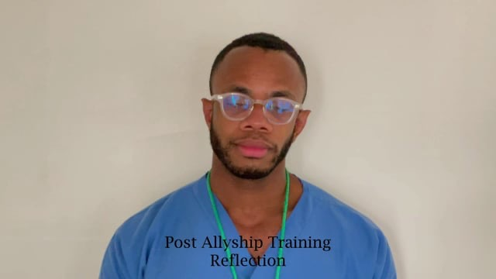

Slide 11
Allyship and Strategies
RE-DIRECT: Shift the focus to a different person or topic. (Particularly helpful when someone is asked to speak for his/her entire race, cultural group, etc.)
USE PREFERENCE STATEMENTS: Clearly communicating one’s preferences rather than stating them as demands or having others guess what is needed.
REVISIT: Even if the moment of a microaggression has passed, go back and address it. Research indicates that an unaddressed microaggression can leave just as much of a negative impact as the microaggression itself.
https://diversity.ucsf.edu/sites/diversity.ucsf.edu/files/Tools%20for%20Department%20Chairs%20and%20Deans.pdf

Slide 12

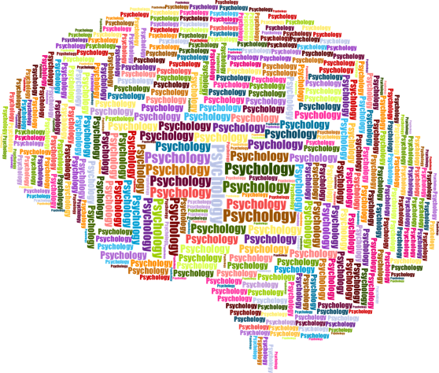
The world we encounter is complex and we seek patterns to make sense of the sensory manifold
What’s behind this phenomenon?

Slide 13
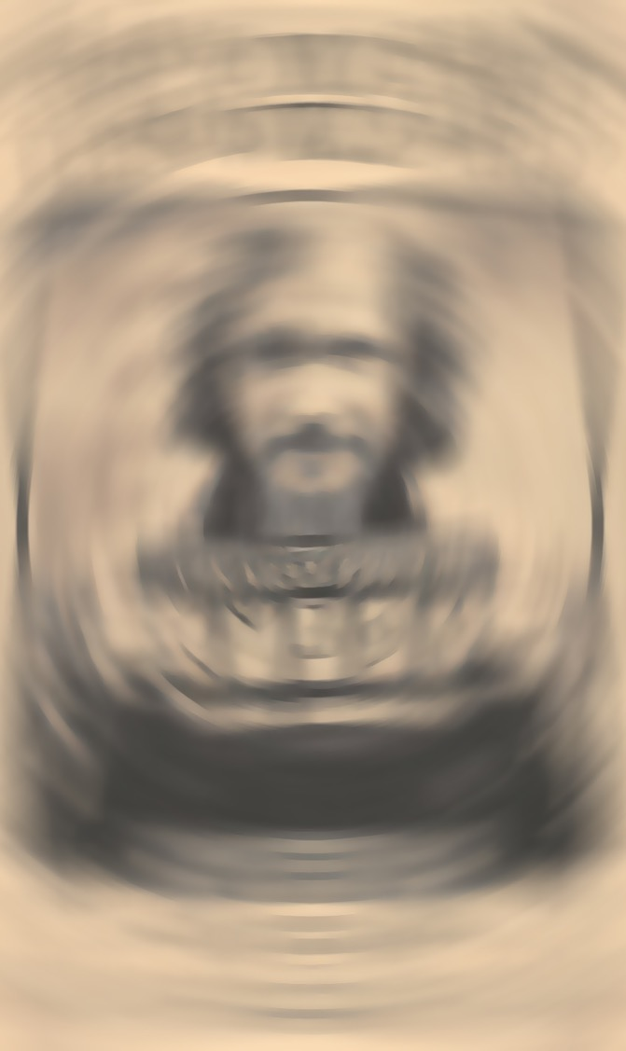
Above the level of patterns found through sensory intuitions, we layer on conceptual patterns or gestalts
What’s behind this phenomenon?

Slide 14
Once we have applied our sensory and conceptual patterns, we take shortcuts to generalize based on salient but scant features
What’s behind this phenomenon?

Slide 15

And finally, we apply what we have learned through family, society and media, to a large extent unconsciously, to assist us in recognizing danger or ease our ability to respond “appropriately” to the world around us
What’s behind this phenomenon?
Warner Bros ; 1492 Pictures ; Heyday Films ; producers, Chris Columbus, David Heyman, Mark Radcliffe ; screenplay, Steve Kloves ; directed by Alfonso Cuarón. Harry Potter And the Prisoner of Azkaban. Burbank, Calif. :Warner Home Video, 2004.

Slide 16
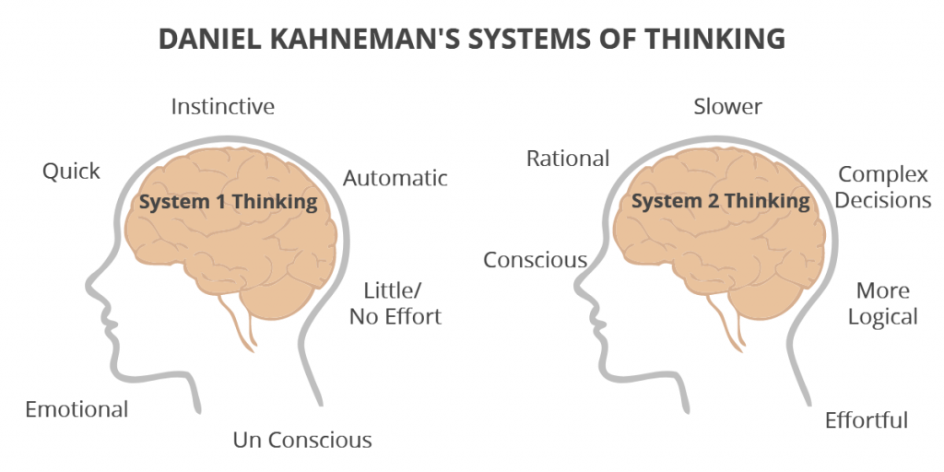
What’s behind this phenomenon?
Kahneman, D. (2011). Thinking, fast and slow. Macmillan.

Slide 17
What’s behind this phenomenon?
implicit bias explicit bias

Slide 18
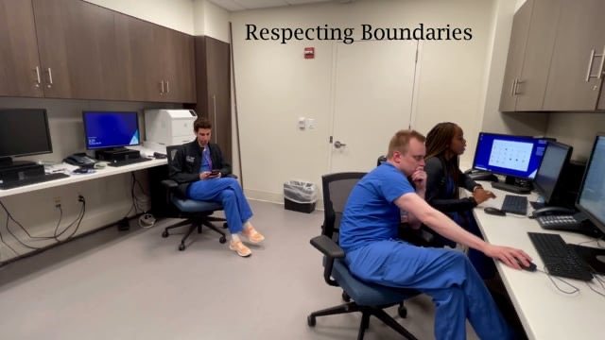

Slide 19
Allyship and Strategies
IMPACT STATEMENTS: A clear, nonthreatening way to directly address these issues is to focus on the affected individual rather than the person. It communicates the impact of a situation while avoiding blaming or accusing the other to reduce defensiveness.
https://diversity.ucsf.edu/sites/diversity.ucsf.edu/files/Tools%20for%20Department%20Chairs%20and%20Deans.pdf

Slide 20
Why is this such a difficult concept?
Implicit bias: attitudes we have towards people or associate stereotypes with them without our conscious knowledge
Microaggressions: the kinds of remarks, questions, or actions that are painful because they have to do with a person's membership in a group that's discriminated against or subject to stereotypes. And a key part of what makes them so disconcerting is that they happen casually, frequently, and often without any harm intended, in everyday life

Slide 21
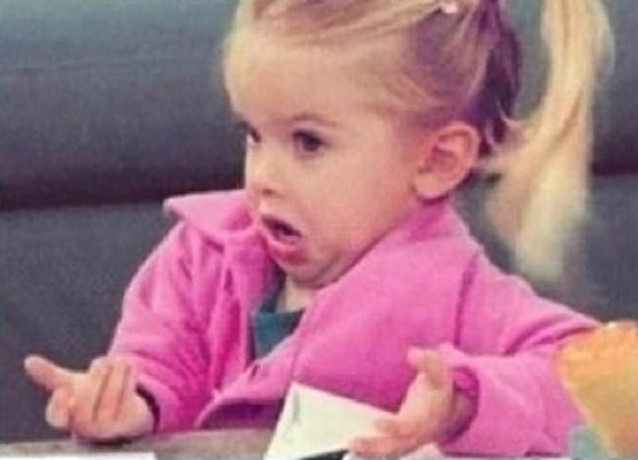
Why is this such a difficult concept?
What??
What did I say?
“without our conscious knowledge”
“they happen casually, frequently, and often without any harm intended”

Slide 22
Why is this such a difficult concept?
Etiquette: the customs or rules governing behaviour regarded as correct or acceptable in social or official life
Courtesy is politeness, respect, and consideration for others.
Manner: a person's bearing and behaviour
THESE EVOLVE OVER TIME
https://www.collinsdictionary.com/us/

Slide 23
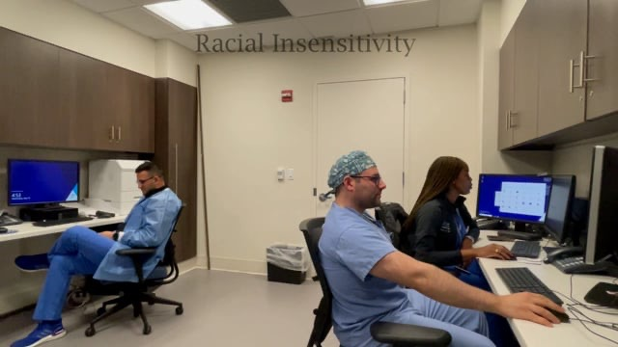

Slide 24
Allyship and Strategies
USE STRATEGIC QUESTIONS: It is the skill of asking questions that will make a difference. A strategic question creates motion and options, avoids “why” and “yes or no” answers, is empowering to the receiver, and allows for difficult questions to be considered. Because of these qualities, a strategic question can lead to transformation. Useful in problem solving, difficult situations, and change efforts.
https://diversity.ucsf.edu/sites/diversity.ucsf.edu/files/Tools%20for%20Department%20Chairs%20and%20Deans.pdf

Slide 25
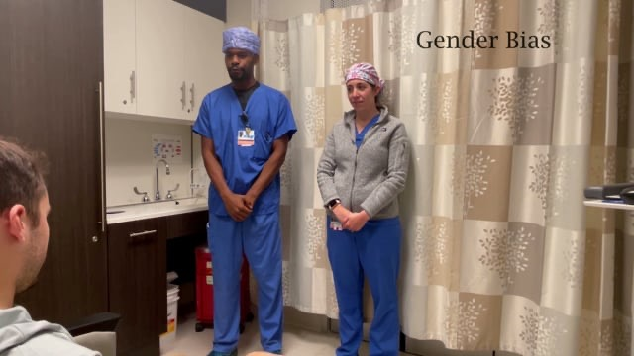

Slide 26
Allyship and Strategies
PARAPHRASE/REFLECT: Reflecting in one’s own words the essence of what the speaker has said. Paraphrasing demonstrates understanding and reduces defensiveness of both you and the speaker. Restate briefly in your own words, rather than simply parroting the speaker. Reflect both content and feeling whenever possible.
REFRAME: Create a different way to look at a situation
https://diversity.ucsf.edu/sites/diversity.ucsf.edu/files/Tools%20for%20Department%20Chairs%20and%20Deans.pdf

Slide 27
Allyship and Strategies
TOOLS FOR ADDRESSING MICROAGGRESSIONS
IMPACT STATEMENTS
USE STRATEGIC QUESTIONS
PARAPHRASE/REFLECT
REFRAME
RE-DIRECT
USE PREFERENCE STATEMENTS
REVISIT

Slide 28
Our other work…
Addressing the bigoted patient
Institutional policies to:
protect employees
provide strategies
for addressing bias
**All characters in these scenarios are
actors with knowledge of the script
EXCEPT the bystander.**
Andre Savadjian, M.D.

Slide 29
Our other work…
implicit bias explicit bias

Slide 30
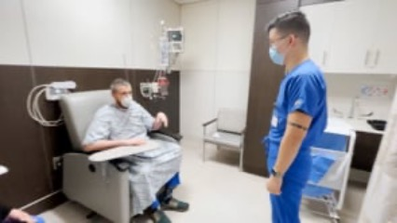

Slide 31
Questions?
Resources:
https://diversity.ucsf.edu/sites/diversity.ucsf.edu
Ehie, Odinakachukwu; Muse, Iyabo; Hill, LaMisha; Bastien, Alexandra. Professionalism: microaggression in the healthcare setting, Current Opinion in Anaesthesiology: April 2021 - Volume 34 - Issue 2 - p 131-136
Acholonu et al. “Interrupting Microaggressions in Health Care Settings: A Guide to Teaching Medical Students.” MedEdPortal 2020;16:10969.
Burgess et al. Reducing racial bias among health care providers: lessons from social-cognitive psychology. Society of General Internal Medicine. 2007; 22:882-887.
Sotto-Santiago S, et al. “I Didn’t Know What to Say”: Responding To Racism, Discrimination, and Microaggressions with the OWTFD Approach. MedEdPortal 2020;16:10971. https://doi.org/10.15766/mep_2374-8265.10971.

